Slide 1
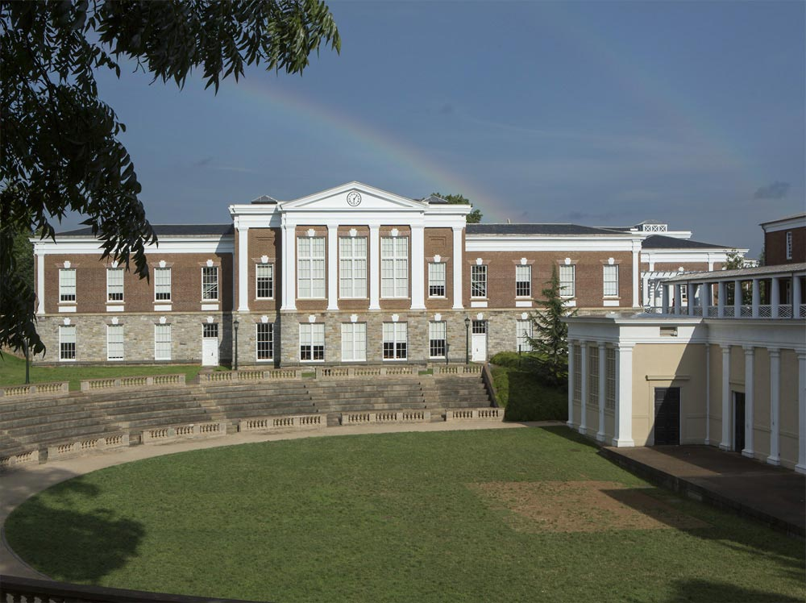
Classics Graduation 2020

Slide 3
Summer Allen

Slide 4
Alex Balbus

Slide 5
Alek Blumberg

Slide 6
Abigail Bright

Slide 7
Daniel Cannon

Slide 8
Clare Draper

Slide 9
Tom Ferguson

Slide 10
Wyatt Joyner

Slide 11
Savhanna Long

Slide 12
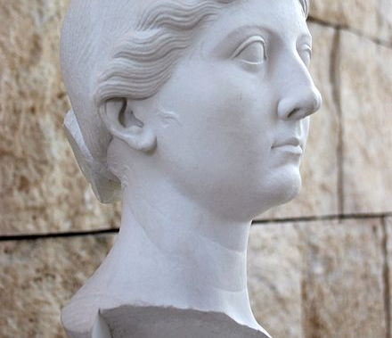
Brittany Morris

Slide 13
Caitlin Rudy

Slide 14
Nicholas Schreiber

Slide 15
Annika Tallis

Slide 16
Apollo Yong

Slide 17
Awards
Awards
Marian W. Stocker Prize
For distinguished work in the major by one intending to teach high-school Latin
Savhanna Shea Long
J. P. Elder Prize
For distinguished work in the major
Annika Emily Tallis
Anne Mary Owen Prize in Classics
For distinguished work in Classics
Clare Hill Draper
Anne Marye Owen Prize in Greek
For distinguished work in first-year Greek
Abigail Staub
Anne Marye Owen Prize in Latin
For distinguished first-year work in advanced Latin
Thomas Murray, Abigail Lund, Megan Sullivan

Slide 18
Alison Newman

Slide 19
Nina Raby

Slide 20
William Stover

Slide 21
Brett Evans

Slide 22
Rebecca Frank

Slide 23
Classics Graduation 2020

